Slide 1
Development of great vessels and their anomalies
Presenter: Dr. Monisha D’souza
Chair Person: Dr Dolly Mathew

Slide 2
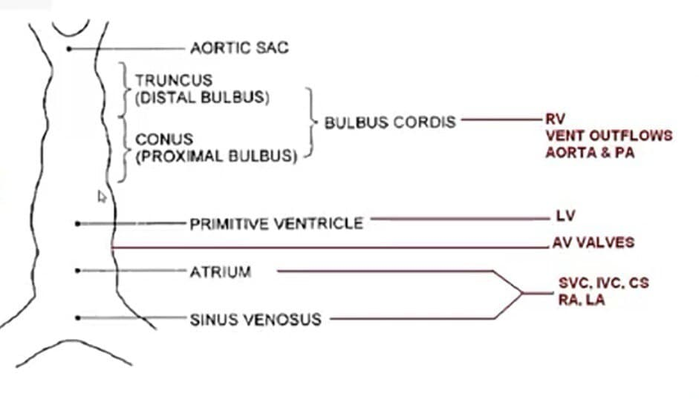
Development
Primitive cardiac tube Bulboventricular tube
Straight heart tube is formed by ventral midline fusion of myocardial and endothelial cells

Slide 3
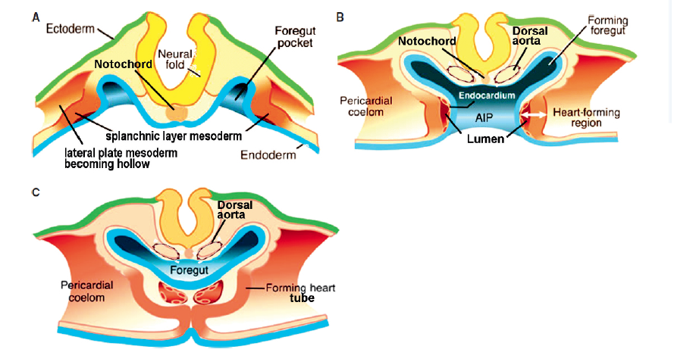

Slide 4
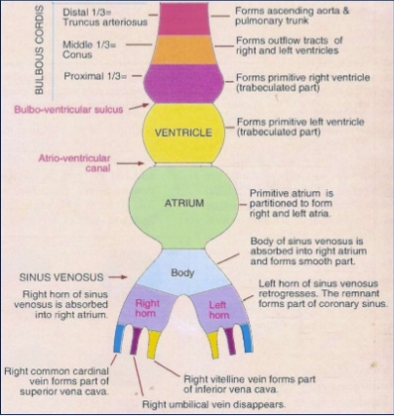

Slide 5
Primary heart tube - two symmetrical cardiogenic plates- bilateral splanchnic mesoderm
Lies on dorsomedial side of endoderm – called ‘first heart field or ‘primary heart field (PHF)’
The second heart field (SHF) or anterior heart field (AHF)- cardiogenic precursor cells- adjacent and posterior to the outflow-tract region
below caudal pharynx, posterior to splanchnic mesoderm- forms a primitive outlet (PO).

Slide 6
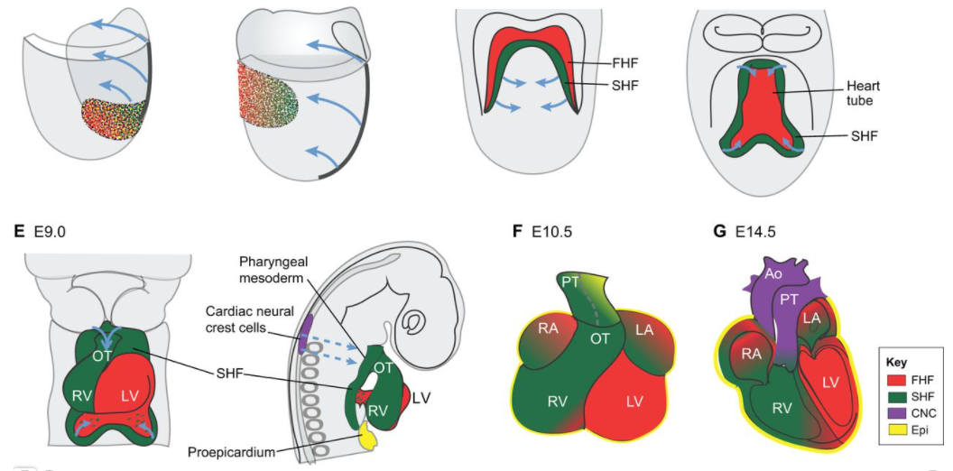
Heart fields

Slide 7
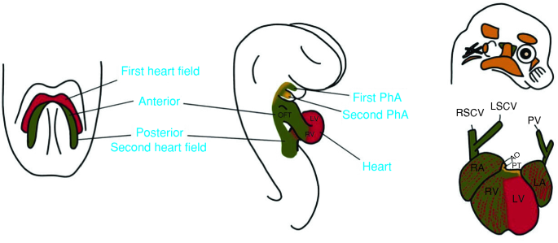

Slide 8
Outflow region of the developing heart: Bulbus Cordis
Conus : The myocardial segment between ventricle and semilunar valves – forms outflow tract proximal to ventricles.
After septation and rotation, it persists in normal heart as subpulmonary infundibulum and disappears on the subaortic side by myocardial regressive absorption.
It includes: Proximal third- trabeculated part of RV
Mid portion: Conus Cordis- outflow tract of both
ventricles

Slide 9
Truncus: The fibrous segment between semilunar valves and aortic sac.
Distal third- Truncus- roots and proximal parts of aorta and pulmonary arteries
Invagination and elongation of the aortic sac into the interior of the pericardial cavity- to form truncus.

Slide 10
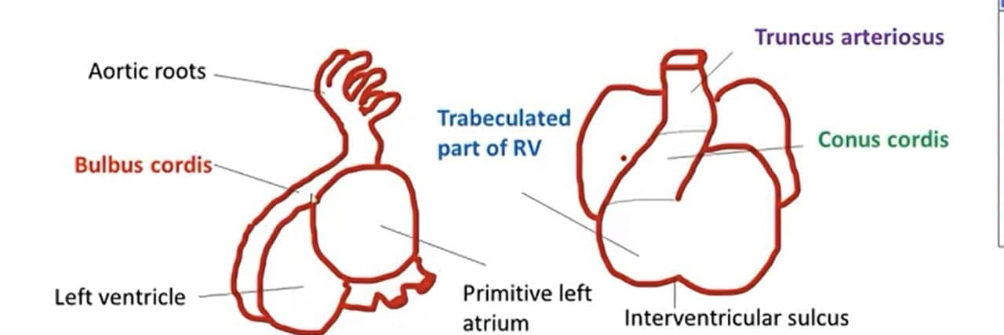

Slide 11
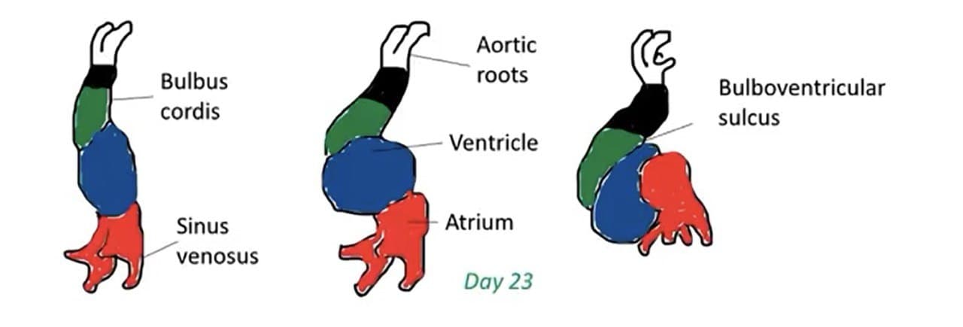
Conotruncal development
As cono-truncus elongates cells are added from secondary heart field.
Neural Crest cells contributes to endocardial cushion formation, semilunar valves and controls cell production and lengthening of outflow region

Slide 12
This lengthening is needed for formation of RV, the outflow tracts and for looping
For proliferation following cell types are needed:
  Secondary heart field
  Neural crest cells
  Myocardium
  Endocardium

Slide 13
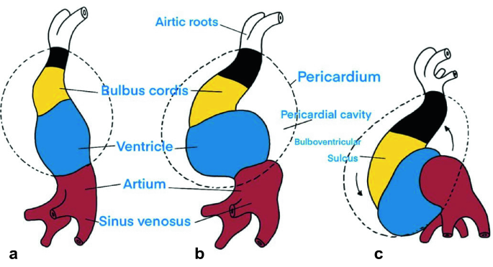
  First Looping- The rightward looping of heart (C-shaped heart tube)

Slide 14
Second looping:
Myocardial cells from outflow and inflow portions- elongate truncus and conus [dorso-caudal direction]
Primitive atrium and AV canal move in dorsocranial direction behind ventricular regions.
The primitive left and right ventricles- transversally oriented
Venous pole moves anteriorly and dorsally- inflow and outflow regions become evident.

Slide 15
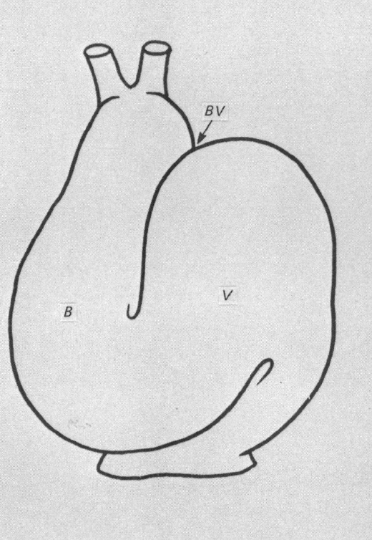

Slide 16
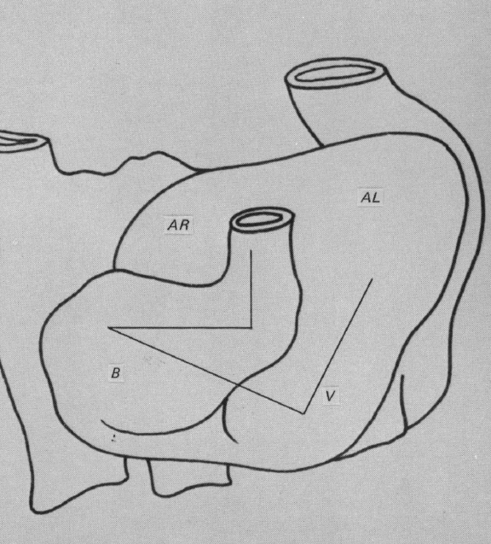

Slide 17
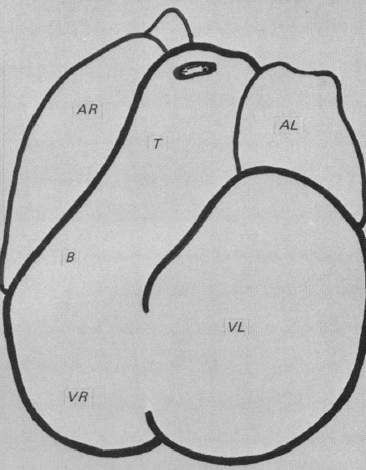

Slide 19
Cardiac Neural Crest
A subregion of the cranial neural crest cells from midotic placode level to third somite-cardiac neural crests
They migrate to third, fourth, and sixth pairs of pharyngeal arches and into the heart
Growth factors signals- Wnt-signaling molecules, FGFs, BMPs, and retinoic acid are required for neural crest induction - NKx2.5 and Gata4 transcription factors- induces local primary myocardial Bmp2 factor
* [fibroblast growth factor, bone morphogenetic protein, Hedgehog, and retinoic acid]

Slide 20
They differentiate into mesenchymal and smooth muscle cells- contribute to:
the septation of the outflow tract
formation of separate walls of the intrapericardial arterial trunks,
develop into cardiac parasympathetic ganglia of the heart.
support the the caudal pharyngeal arches and aortic arch arteries.
arterial valve leaflets

Slide 21
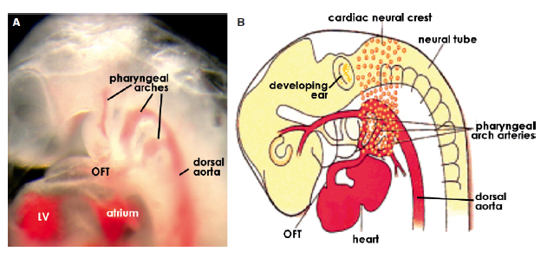

Slide 22
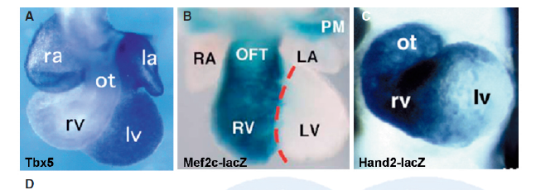

Slide 23
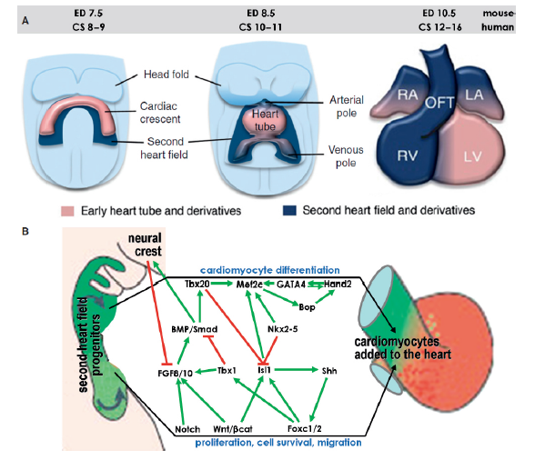

Slide 24
Conotruncus and ostium bulbi
Ostium bulbi : border between meta ampulla and conus. It forms the conoventricular junction.
On the right the Ostium bulbi forms transition from trabeculated ventricular endocardium to the smooth conal endocardium (RV).
On the left the Ostium bulbi is the lower edge of conoventricular flange (LV).

Slide 25
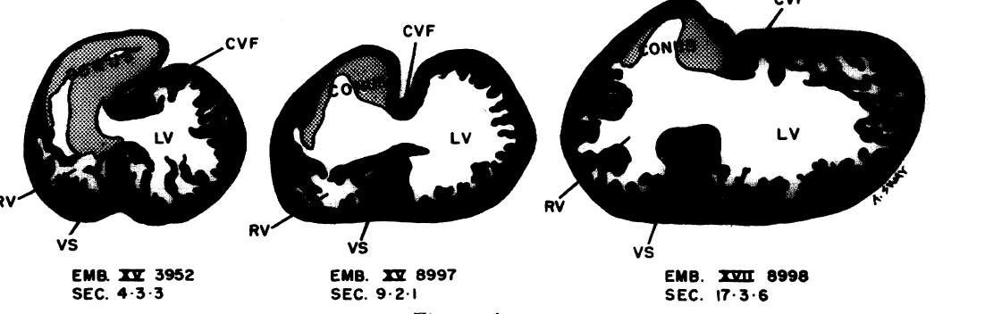
Shift or rotation of ostium bulbi
Ostium bulbi shifts toward the left to cephalically and override the IVF. This critical process provides the conus with an access to the left ventricle.

Slide 26
Rotation of conotruncus- 2 stages:
Stage1 – Inversion of ostium bulbi at same time of looping
Stage 2- Rotation of truncus which occurs after the formation of septum aorto-pulmonale.
Significance:
Ostium bulbar rotation causes the anatomic concordance between the left ventricle and the proximal aortic conus
Truncal torsion in similar manner and bring the semilunar valves to the same sides as their proximal conuses and unwinding the spiral course of the conotruncal ridges.

Slide 27
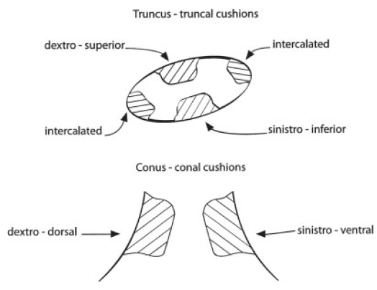
DEVELOPMENT OF THE TRUNCUS
SWELLINGS AND CONUS RIDGES

Slide 28
Two truncus swellings are formed- proliferation of mesenchymal cells.
They grow and twist along the inner wall of the truncus.
They are the sinistro-inferior truncus swelling and dextro-superior truncus swelling.

Slide 29
The SI truncus swelling joins the sinistroventral conus ridge, grows towards the lower left margin of the orifice of the sixth aortic arch artery (along floor of truncus cavity).
The DS truncus swelling joins the developing dextro-dorsal conus ridge- grows towards the upper right margin of the orifice of the sixth aortic arch artery (along the roof of the truncus cavity)

Slide 30
The distal part of these truncus swellings (TS) twist on each other at the trunco-conal curvature.
Now the dextro-superior TS comes opposite to the cranioventral part of the sinistro-inferiorTS.
Pulmonary trunk becomes continuous with right ventricle outflow tract (crista supraventicularis).
The sinistro-inferior TS becomes aligned with the superior atrioventricular endocardial cushion, that connects the ascending aorta to the left ventricle

Slide 31
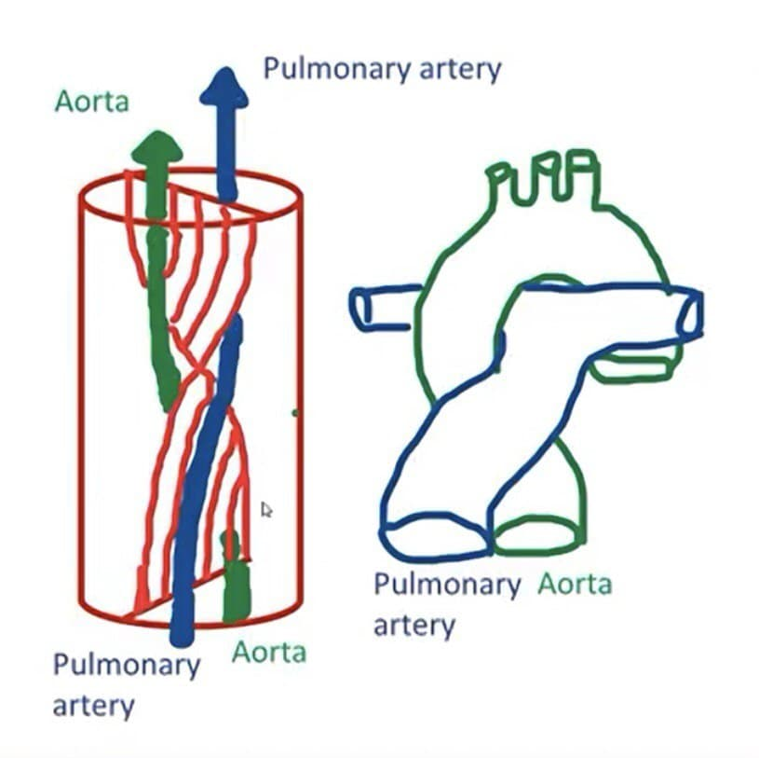
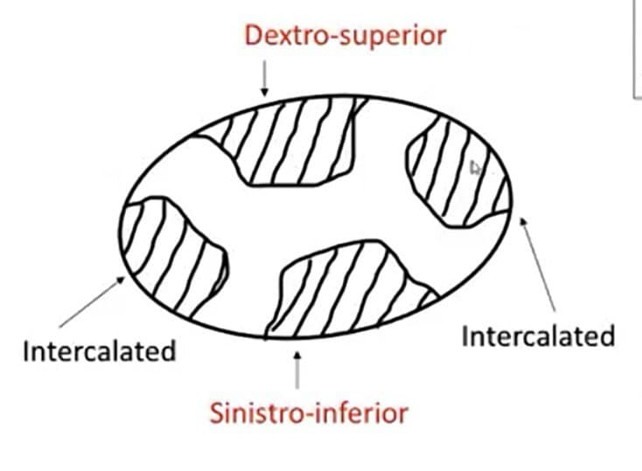
Truncal septum

Slide 32
The pulmonary trunk orifice retains its position, while the aorta (dextro dorsal location) moves vertically towards the left ventricle side.
The proximal truncus swellings are differentiated into valvular tissue -right and left semilunar valves of the aorta and pulmonary trunk.

Slide 33
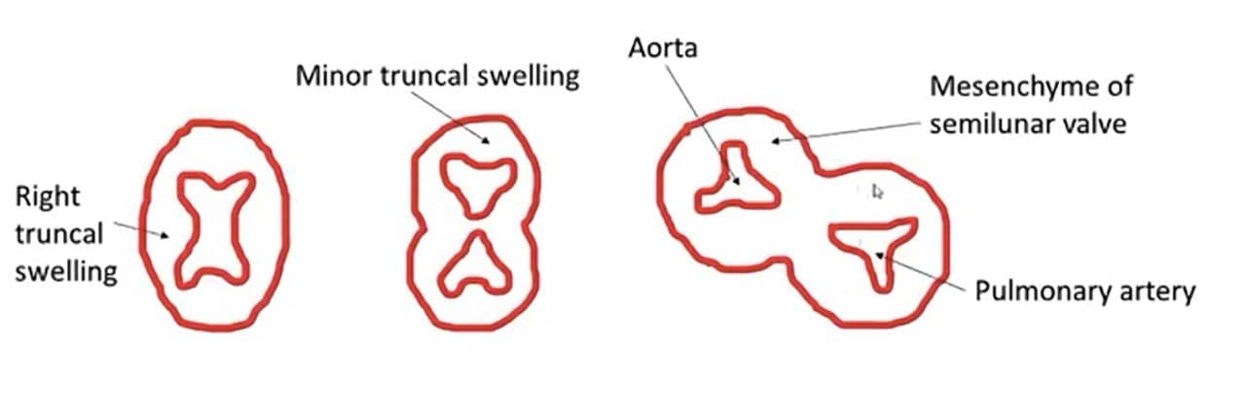
Transverse section of truncus arteriosus at the level of semilunar valves

Slide 34
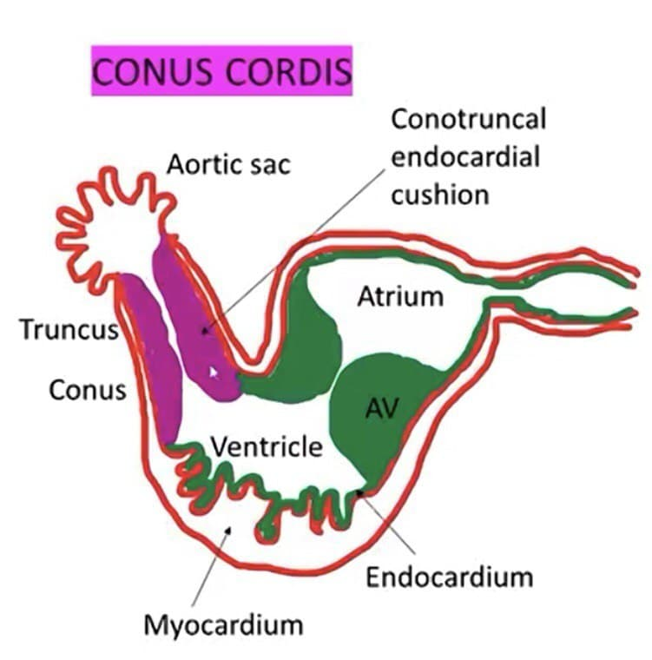
Conus cordis
Same time when the truncal swellings appear, similar cushions appear in the right dorsal and left ventral wall of conus
They grow towards each other and distally unite with truncal septum

Slide 35
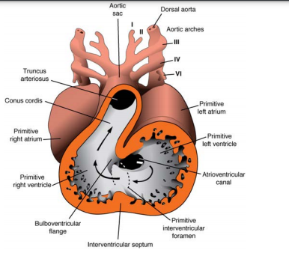
Conus cordis
This septum divides the conus cavity into:
-1) antero lateral portion i.e. RVOT
-2) postero medial portion i.e. LVOT

Slide 36
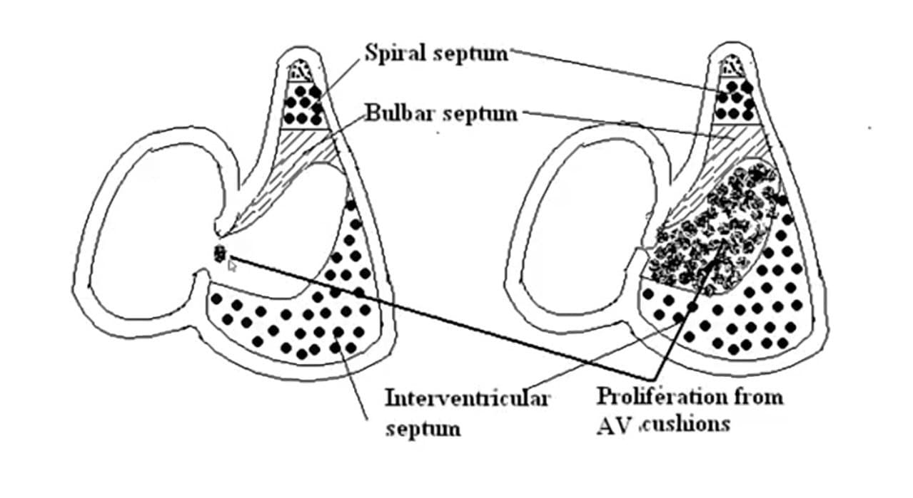
Sagital section

Slide 37
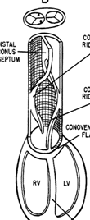
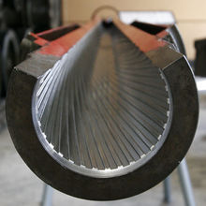
Conotruncal ridges
The conotruncal ridges are arranged in a spiral course, like riflings of a gun barrel.

Slide 38
The truncus rotates about 90-110° in a counterclockwise direction.
This rotation follows the earlier counterclockwise rotation of the ostium bulbi and unwinds the coiled course of the conotruncal ridges .
As a result, the aortic truncus is transferred to the same side as the aortic conus (left side) and the aortic and pulmonary trunks become coiled, this situation is seen in the definitive heart.

Slide 39
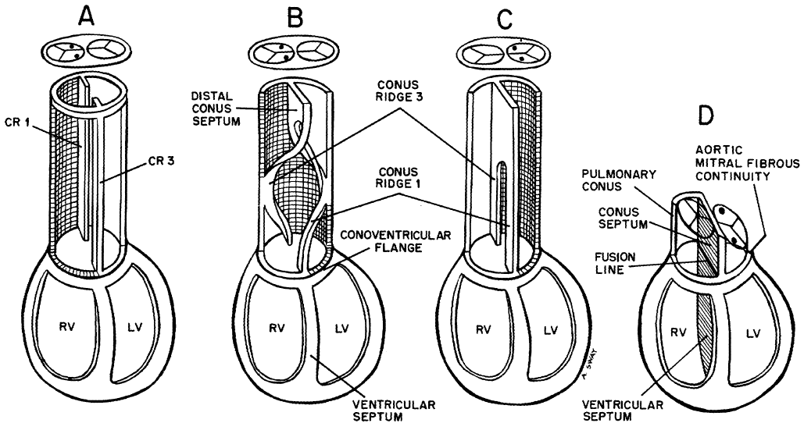
Aortic truncus
Pulmonary
truncus

Slide 40
Distal truncus swellings - formation of ‘aorticopulmonary septum’.
Proximal truncus swellings- formation of semilunar valves.
Conus ridges- muscle band (crista supraventricularis).

Slide 41
Outcome of conotruncal rotation
Conus septum- fusion of SVCR and DDCR.
The conus septum antero-lateral portion: outflow of RV
Postero-medial portion of conus: outflow portion of LV.
Truncus septum- fusion of SITR and DSTR.
Pulmonary trunk aligned to right ventricle.
Ascending aorta aligned to left ventricle (through aortic vestibulum)

Slide 42
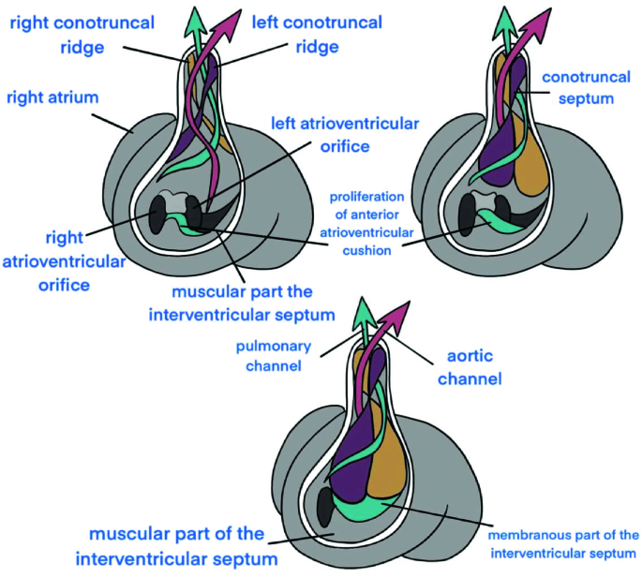

Slide 43
Shortening of conus with lengthening of the aorta and pulmonary arteries.
The aortic conotruncus is reduced from 700 to 400 microns.
The pulmonary conotruncus is reduced from 880 to 600 microns.
Distal aortic conus gets absorbed-the fibrous continuity between the aortic and mitral valves.

Slide 44
Distal conus extends towards the ventricular septum- contributes to IVS- right side- defect: supracristal VSD.
Muscular elements of RV invade the conus septum- gives anatomic appearance of the crista supraventricularis.

Slide 45
Distally truncus is continuous with the aortic sac (ventral aorta).
Septum aortopulmonale arises from the dorsal wall of the aortic sac- grows toward truncal septum- fusion.
Aortic sac is divided into the ascending aorta and the pulmonary artery .

Slide 46
FORMATION OF THE AORTIC ARCHES
Blood islands formed–angioblast-acquire lumen + fusion- plexus of blood vessels- aortic arch arteries.
Aortic sac – initially in branchial mesenchymal tissue.
Then aortic sac projects into the pericardial cavity- third and fourth aortic arch arteries sprout out.
Last to form- a pair of thin sixth aortic arch and gradually fuses to form the pulmonary trunk.

Slide 47
Aortic arches
Aortic sac forms the right and left horns
Each pharyngeal arch receives its own artery
Aortic arches arise from the aortic sac – the most distal part of truncal arteriosus and terminate in the right and left dorsal aortae

Slide 48
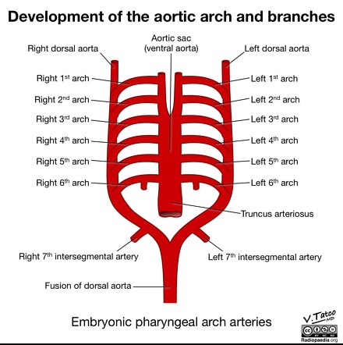
Aortic arches
Pharyngeal arches and their vessels appear in cranial to caudal sequence
There are total of 6(5) pairs of arteries (Fifth arch either never forms or forms and regresses)
3rd , 4th, 6th arches are large arches

Slide 49
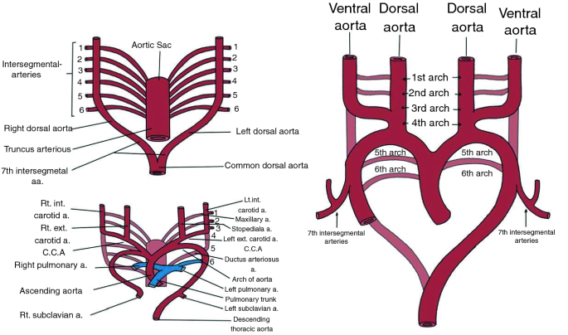

Slide 50
First aortic arch:
regresses at development of the third arch, except small part which forms maxillary artery
Second aortic arch:
Regresses- accept small part that forms stapedial artery.

Slide 51
Aortic arches
Right horn gives to brachiocephalic artery
Left horn to proximal segment of arch
3rd arch- Common carotid artery and first part of ICA (remaining ICA is from cranial portion of dorsal aorta), ECA sprouts from 3rd arch
4th arch-
  Left side – part of arch of aorta between left CCA and left SCA
  Right side – proximal segment of right SCA (distal part formed by portion of right dorsal aorta and 7th intersegmental artery)
6th arch (Pulmonary arch)- Right side- proximal part becomes proximal part of RPA, distal part disappears
  Left side- Proximal part becomes part of LPA, distal persists as PDA

Slide 52
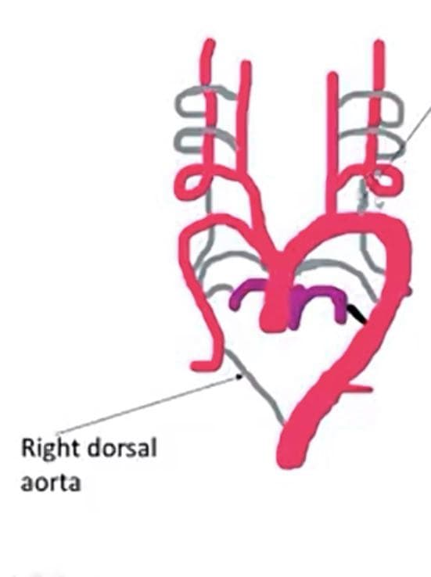
Other Changes
Dorsal aorta between the entrance of 3rd and 4th arch (carotid duct) disappears
Right dorsal aorta disappears between the origin of 7th intersegmental artery and the junction with the left dorsal aorta

Slide 53
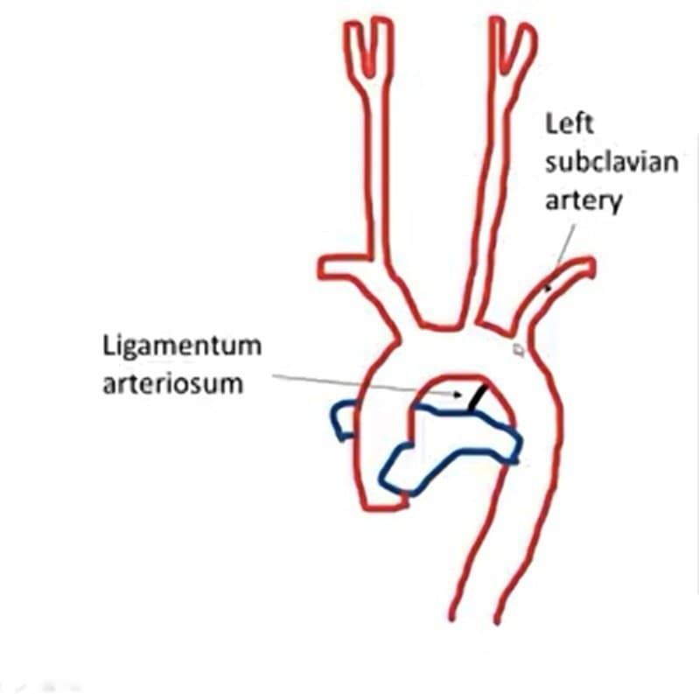
Other Changes
Carotid and brachiophalic arteries elongate as the heart is pushed into thorax
The left subclavian artery shifts its origin from aorta at the 7th intersegmental artery to close to left common carotid artery

Slide 54
Intersegmental Arteries
Intersegmental artery | Development
Cervical | All except 7th merge into vertebral artery
7th cervical intersegmental | Subclavian artery
Thoracic | Intercostal artery
Lumbar | All except 5th -becomes lumbar arteries
5th Lumbar | Common iliac artery
Sacral | Lateral sacral artery

Slide 55
Conotruncal defects
  Mechanisms:
  Insult to neural crest cells and disrupt formation of conotruncal septum
  Insult to Neural crest that disrupt the signals to SHF
  Direct insult to SHF
Basis for understanding abnormal facial features in children with Conotruncal abnormalities

Slide 56
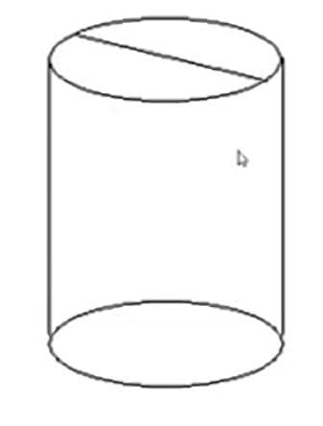
Conotruncal defects
Failure of formation of conotruncal ridges leads to non division of outflow tract
  Lack of formation of truncoconal septum
  Truncus arteriosus
  (Since the ridges are also responsible for formation of IVS, VSD is associated)
Partial truncoconal septal defect
  AP window, Supracristal VSD

Slide 57
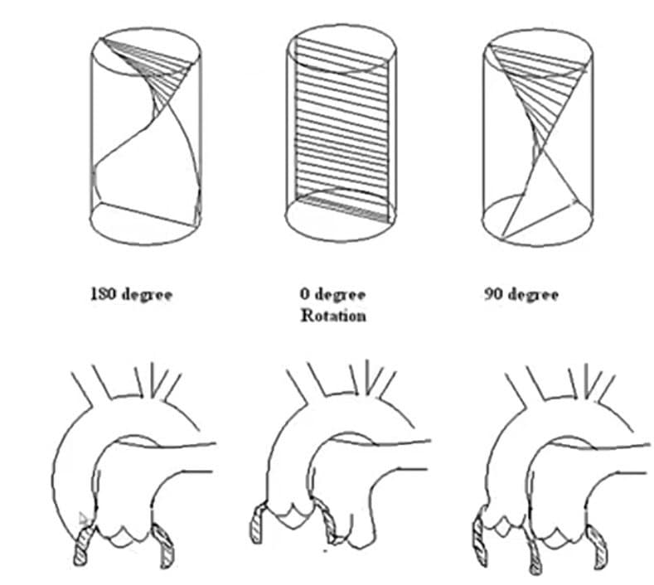
Conotruncal defects
Normal course if the conotruncal septum is 180 degrees rotation
Complete failure of rotation i.e.; 0 degrees
  -Transposition of Great Arteries
90 degree rotation of conotruncus side by side vessels
  DORV

Slide 58
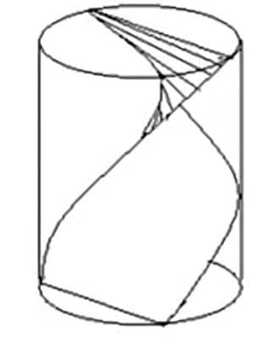
Conotruncal defects
Uneven septation at the expense of pulmonary side resulting from anterior displacement of conotruncal septum leads to Tetrology of Fallot
Lack of development or uneven septation of conotruncus leads to PS/PA/AS/AA
Semilunar valves fused for variable distance leads to Valvular Stenosis of PA or Aorta

Slide 59
TETROLOGY OF FALLOT
Mechanism:
- Conal septum deviates anteriorly- faulty partition of conotruncal septum.
Abnormal conal rotation with malrotation of trunco-bulbar ridges: malalignment of septum and straddling of aorta over VSD
- Hypoplasia and under development of the pulmonary infundibulum- infundibular hypoplasia.

Slide 60
Common arterial trunk (CAT)
Rare congenital heart disease. Other name: Persistent Truncus Arteriosis.
Consequence of anomaly in wedging and convergence process- conotruncal septation
The total absence - aorticopulmonary septum of the truncus and the interinfundibular or bulbar septum: malformation- truncus arteriosus communis'.
Mechanism: incomplete or failed septation of the embryonic truncus arteriosus.

Slide 61
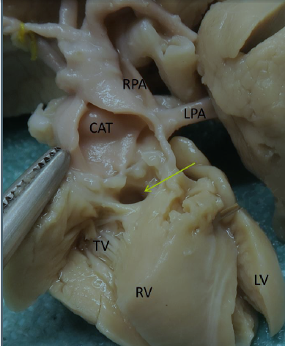

Slide 62
A congenital cardiovascular malformation in which a single arterial trunk arises from the heart, giving origin sequentially to:
the coronary arteries
one or more pulmonary arteries
systemic arterial circulation.
There is therefore a common ventriculo–arterial junction, with a common arterial valve, above a large outlet juxta–arterial VSD.

Slide 63
TRANSPOSITION OF GREAT ARTERIES
Ventriculoarterial discordance: Aorta from morphological RV, pulmonary from morphological LV.
Aorta: right and anterior to pulmonary artery.
Great arteries- parallel placement with parallel circulation.

Slide 64
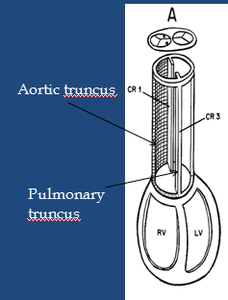
Mechanism: arrest of both proximal & distal conal rotations
Aorta is dextro-posed: right side of the pulmonary artery with no continuity with left ventricle

Slide 65
Need for communication- mixing blood: either ASD or VSD or PDA.
Allows oxygenation in pulmonary circuit -then entry into systemic circulation- to support life.
MC lesion-VSD (50% cases).
Rare- pulmonary outflow tract obstruction, coarctation of the aorta (≈5%).

Slide 66
Atrioventricular concordance present.
If no significant additional cardiac lesions -TGA with intact ventricular septum- simple TGA
Complex TGA- associated cardiac anomalies- VSD (upto 45%), LVOT obstruction (25%) and coarctation of the aorta (5%).
TGA- not familial- 2:1 male preponderance.

Slide 67
Newborn with TGA +IVS- symptomatic from birth (day 1 cyanosis).
Severe cyanosis is an early, almost universal clinical finding- only sign in first hours after birth.
Screening for arterial oxygen saturation (SaO2) is indicated for early identification (asymptomatic)
Especially when pre- or post-ductal or both spo2 values are <95%

Slide 68
Prenatal detection: screening at obstetric anomaly scan.
Apical four chamber-lower rates of detection of TGA
Inclusion of the outflow-tract views – significant improvement in prenatal detection of TGA [ by upto 50%]- recommended

Slide 69
Chest radiographs: normal; or oval or egg-on-side cardiac shape (due to the narrow mediastinum), mild cardiomegaly and increased pulmonary vascular markings.
ECG may be normal or right-axis deviation and right ventricular hypertrophy.

Slide 70
Echocardiography :modality of choice for definitive diagnosis.
To look for root of great arteries and coronary arteries (origin and course), location of the valve commissures, VSD, LVOT obstruction, coarctation and mitral valve anomalies.

Slide 71
Initial management:
Optimize mixing – methods:
- IV infusion of PGE1- ductal patency until postnatal echo is complete and all sites of intercirculatory mixing have been identified.

Slide 72
Dosing regimens: reopen ductus- high dose- 0.1 mg/kg/min
To maintain patency: 0.0125 to 0.05 mg/kg/min.
Wean off after 2–4 hours if oxygen (O2) saturations and tissue perfusion are good.

Slide 73
If restrictive interatrial communication-ductal shunting will be inadequate- PGE1 may not suffice - emergency atrial septostomy.
Patients with deep hypoxaemia and acidosis: PGE1 infusion at 0.1 mg/kg/min while preparing for the atrial septostomy.

Slide 74
Arterial switch operation
ASO for TGA IVS -introduced in the early 1980s.
Neonatal left ventricle suited for systemic work (withstood systemic pressure in throughout foetal life ).
The neonatal ASO -preferred approach- surgical mortality rate of 2–5% .

Slide 75
At birth, the LV muscle mass and RV mass are equal. Later due to rapid postnatal decrease in PVR- LV becomes ‘deconditioned’- loss of muscle mass- unable to withstand systemic workload.
Optimal timing: first few days to 3 weeks of life.

Slide 76
DORV
Impaired morphogenesis of either the outflow portion (conotruncus) or the conoventricular flange
Abnormal connection between the muscular ventricular septum and the conus septum
And hence sub aortic flow path from right ventricle
Originally both vessels arise from RV and if no conoventricular shifting occurs then DORV

Slide 77
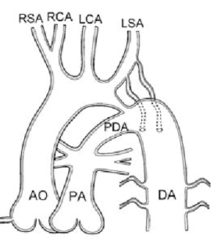
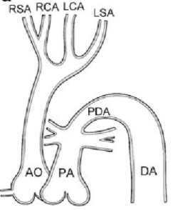
Arterial system defects
Interrupted arch of Aorta (IAA): Complete obliteration of 4th arch
Coarctation of Aorta: Partial obliteration of 4th arch

Slide 78
Interrupted Aortic Arch
IAA- a complete discontinuity or a nonpatent fibrous strand in the transverse arch or aortic isthmus.
The types of IAA were described by Celoria and Patten- based on the site of aortic arch interruption.
- Type A: interruption is distal to the left SCA.
- Type B: interruption is between the left CCA and left SCA- MC.
- Type C: interruption is between the innominate and left CCA- rarest.

Slide 79
Associated lesions: VSDs, TA, LVOTO, valvular aortic stenosis, transposition of great arteries, double outlet right ventricle (DORV) and aorto-pulmonary window (APW).
Type B IAA often associated with DiGeorge syndrome.
Complete DiGeorge syndrome: IAA with dysmorphic facial features; hypocalcaemia and low (<400 cells/mm) CD4+ T-lymphocyte count.
Partial DiGeorge syndrome: dysmorphic facial features with hypocalcaemia and IAA in the absence of any deficit of the CD4+ T-lymphocyte subpopulation

Slide 80
IAA- ductus dependent congenital heart disease
Without corrective surgery- high mortality in the neonatal period.
Feasible to repair IAA-VSD within the first month after birth.

Slide 81
Coarctation of aorta
Tight stenosis distal to the left subclavian artery.
It accounts for approximately 5–7% of all congenital heart diseases.
Mechanisms: three hypotheses:-
a) tissue from ductus arteriosus enters into the aortic wall where it connects to descending aorta. Ductus constricts in postnatal period - tissue in the isthmus constricts.
B) Abnormal preductal flow or abnormal angle between the ductus and aorta leads to increased right-to-left ductal flow , decreased flow across the arch and isthmus.
C) Abnormal involution of small segment of left dorsal aorta- migrates cranially with left subclavian artery.

Slide 82
Significance:
Prone to neurovascular complications- intracranial hemorrhage of aneurysm (12%), intracranial subarachnoid hemorrhage (7%)
Recurrent coarctation, aneurysm, persistent essential hypertension- common after surgical repair.

Slide 83
Pseudocoarctation
Rare anomaly: kinking or buckling of the descending aorta at the level of the ductus arteriosus.
Mechanism- failure of compression and fusion of the third through 10th segments of the dorsal aortic roots and left fourth arch segment.
Significance : may produce conditions for development of aneurysm, with risk of rupture.
Careful follow-up and surgical treatment is recommended.

Slide 84
ARCH ABNORMALITIES

Slide 85
Normal left aortic arch
The normal left aortic arch- formed by involution of the distal right fourth arch (between the right subclavian artery and descending aorta)
Regression of the right ductus arteriosus and right dorsal aorta distal to the origin of the seventh intersegmental artery (precursor to the distal subclavian artery).
The remainder proximal part of the right fourth arch forms the proximal part of the right subclavian artery
The left fourth arch forms the definitive aortic arch.
The distal right subclavian artery is formed from a part of the right dorsal aorta and the right seventh intersegmental artery

Slide 86
bovine arch anomaly
Common arch variant seen in 10–20% people
Term is misnomer- it refers to the shared, or direct origin of the left common carotid and innominate artery.
Significance:
Association with thoracic aortic aneurysms in elder populations
Increased rate of neurological complications in carotid stenting procedures.

Slide 87
Left aortic arch with aberrant right subclavian artery
Prevalence of 0.5%–2%.
Right subclavian artery arises from the aortic arch distal to the left subclavian artery.
Artery has oblique course (behind esophagus) from caudal left to cranial right.
Mechanism: Involution of the right fourth aortic arch between the right common carotid and right subclavian artery (normally it occurs distal to the right subclavian artery).
Fusion of the right CCA and right SA into brachiocephalic artery fails tooccur.

Slide 88
Left aortic arch now gives rise to four arteries: right CCA, left CCA, left SA, and right SA .
MC course : retroesophageal; others-between the trachea and esophagus or anterior to trachea.
Usually asymptomatic but occasionally- dysphagia, cough, stridor, and thoracic pain from esophageal compression
Significance: Unforeseen issues in transradial cerebral procedures. Approach to ascending aorta by the right trans radial route challenging.

Slide 89
Left circumflex aorta
Extremely rare variant- left aortic arch ascends to the left of trachea, crosses posteriorly and continues as right-sided descending aorta.
Aortic arch itself goes behind the esophagus, right ductus arteriosus connects the right pulmonary artery to descending aorta and forms a vascular ring.
A vascular ring is formed when vessels or their atretic portions entirely encircle the trachea and esophagus- potential airway and esophageal compression.
Mechanism: Regression of the right fourth arch b‐tween the right CCA and right SA with persistence of the right-sided sixth arch component forming the ductus arteriosus.
There is persistence of the proximal left fourth arch forming the definitive aortic arch.

Slide 90
Right aortic arch
Rare anatomical anomaly- 0.1% of population.
Three types according to the branching pattern of the arch vessels:
- a) RAA with an aberrant left subclavian artery
-b) RAA with mirror image branching
-c) RAA with isolation of the left subclavian artery.
Mechanism: Persistence of the right fourth -thoracic aorta with regression of the left dorsal aorta.
It can be pre-tracheal (no symptoms) or retro-esophageal (vascular ring malformation).

Slide 91
Cervical aortic arch
Unusually high position of the aortic arch in the lower mid-neck region- more common on the right.
Mechanism: persistence of the third aortic arch or failure of the fourth aortic arch to descend.
Often associated with micro-deletions: locus 22q11.2- regression or underdevelopment of the fourth aortic arch.
Associated with unusual origins of the ICA and ECA with descending aorta located contra-lateral to the arch.
Significance: most cases-asymptomatic.
uncommon-pulsating mass above the clavicle or compressive symptoms: respiratory difficulty, dysphagia, chest or back pain, aortic aneurysms.

Slide 92
Double aortic arch
MC clinically recognized form of complete vascular ring
Trachea and esophagus are completely encircled by the two arches.
Mechanism: persistence of both the right and left aortic arches.
Each arch gives rise to separate ipsilateral carotid and subclavian-symmetric appearance of the branch vessels.
Both arches are patent- one is typically larger- right arch often dominant- 70% of cases.
MC presentation: large right arch, left-sided descending thoracic aorta, and left sided ligamentum arteriosum.

Slide 93
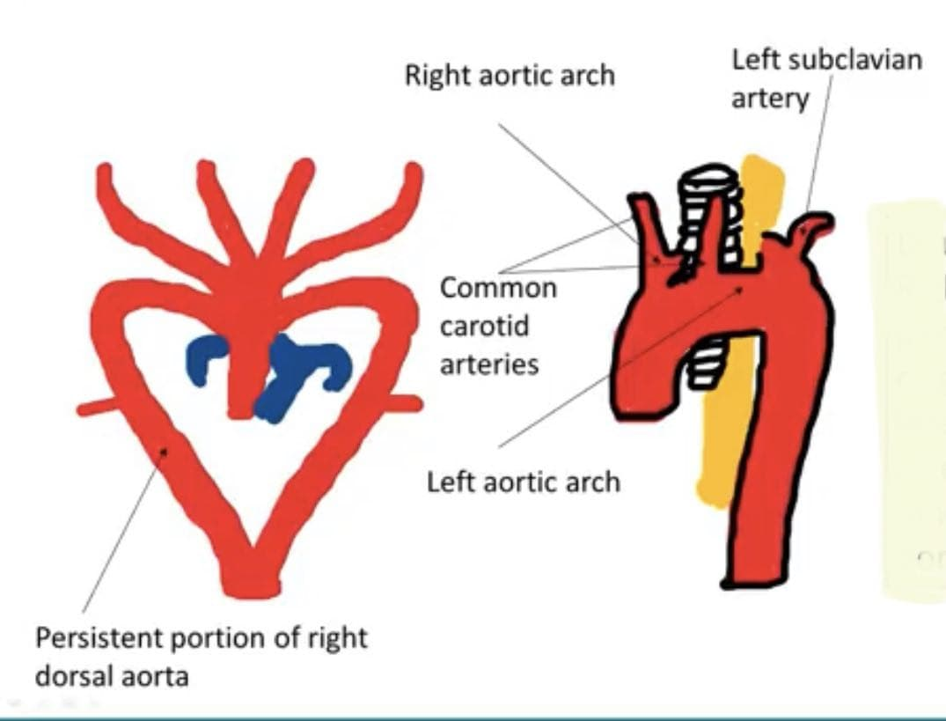
Double aortic arch
Double Aortic arch: Right dorsal aorta persists between the origin of 7th intersegmental artery and its junction with left dorsal aorta
No brachiocephalic artery
Vascular ring

Slide 94
Other variants-vascular rings:
Right aortic arch with aberrant brachiocephalic artery
Right circumflex aorta
Right aortic arch with isolation of the left subclavian artery
Right aortic arch with mirror image branching
Right aortic arch with aberrant left subclavian artery

Slide 95
Summary highlights:
Cardiac looping: heart tube is remodeled to brings the RV and LV to align with the outflow vessels and with atria.
Cardiac neural crest cells: ventriculo-arterial concordance- septation of the outflow tract to yield separate aortic and pulmonary channels.
Aortic remodeling: initial symmetrical aortic arch becomes left-sided (right regresses)

Slide 96
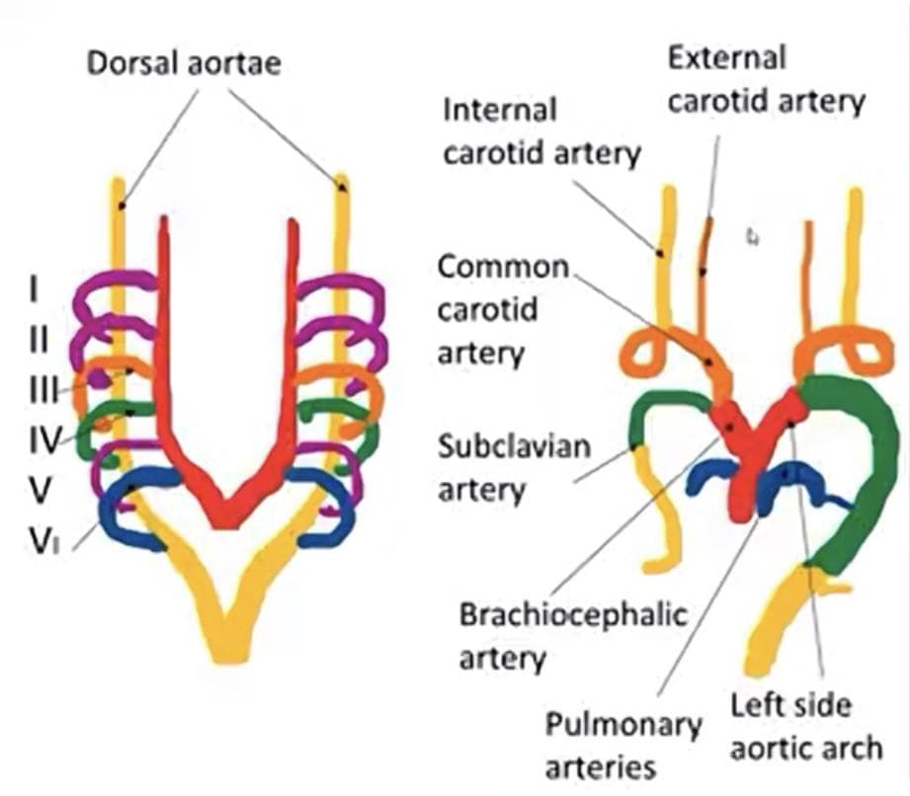
Aortic arches

Slide 97
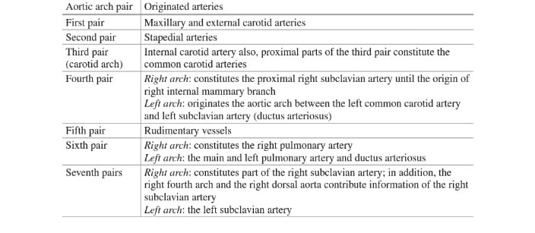

Slide 98
THANK YOU

